Slide 1

Supermarket Retail Analysis: LRFM or RFM?
Presented by Group 5: Clarinda Puspitajati Hans Darmawan
Ridha Hayat
April 7th, 2025
Notes:
Hans/Ridho

Slide 2

Presentation Overview
Introduction: Background & Objectives
Data Analysis: LRFM Methodology
Customer Segmentation: Approaches & Results
Strategic Recommendations: Actionable Insights
Notes:
Hans/Ridho

Slide 3

Background
LRFM analyzes customer value through:
Length: Customer’s age from first transaction
Recency: Last purchase date
Frequency: Transaction count
Monetary: Total spending
Essential for targeted supermarket marketing Helps prioritize customer relationships
Notes:
Claire

Slide 4

Gap Analysis
Current approaches miss high-value customers
One-size-fits-all marketing strategies
Data-driven segmentation needed
Notes:
Claire

Slide 5

Problem Statement
Challenge: Identify loyal, high-spending customers
Budget constraints require smarter targeting
Need: Data-driven customer prioritization
Notes:
Claire

Slide 6

Dataset Overview
1,000 unique supermarket transactions Key metrics:
Transaction dates
Product categories
Customer IDs
Purchase amounts
Time period: 3 months
Notes:
Hans

Slide 7
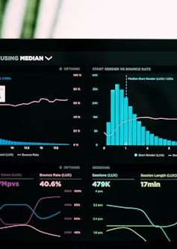
Data Preparation
Tools used:
Pandas for data cleaning
Matplotlib/Seaborn for visualization
Process:
Data validation
Missing value handling
Feature engineering
Notes:
Hans

Slide 8

LRFM Values Calculation
Length: Customer tenure (89 days)
Recency: Days since last purchase
Frequency: Transaction count (77-92)
Monetary: Total spend ($24.7k-$25.7k)
Scoring: 1-5 scale per dimension
Notes:
Hans

Slide 9
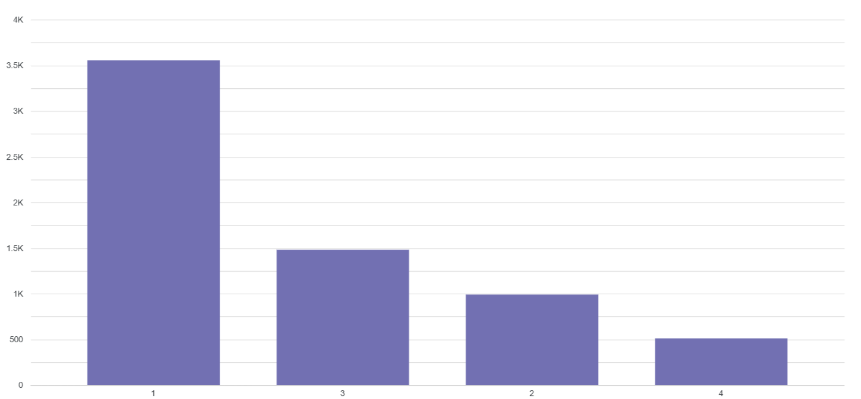
Key Findings: Length & Recency
Notes:
All customers: Same length (89 days) 85% purchased within last 3 days
Length dimension not discriminative
Decision: Focus on RFM instead of LRFM
Hans

Slide 10
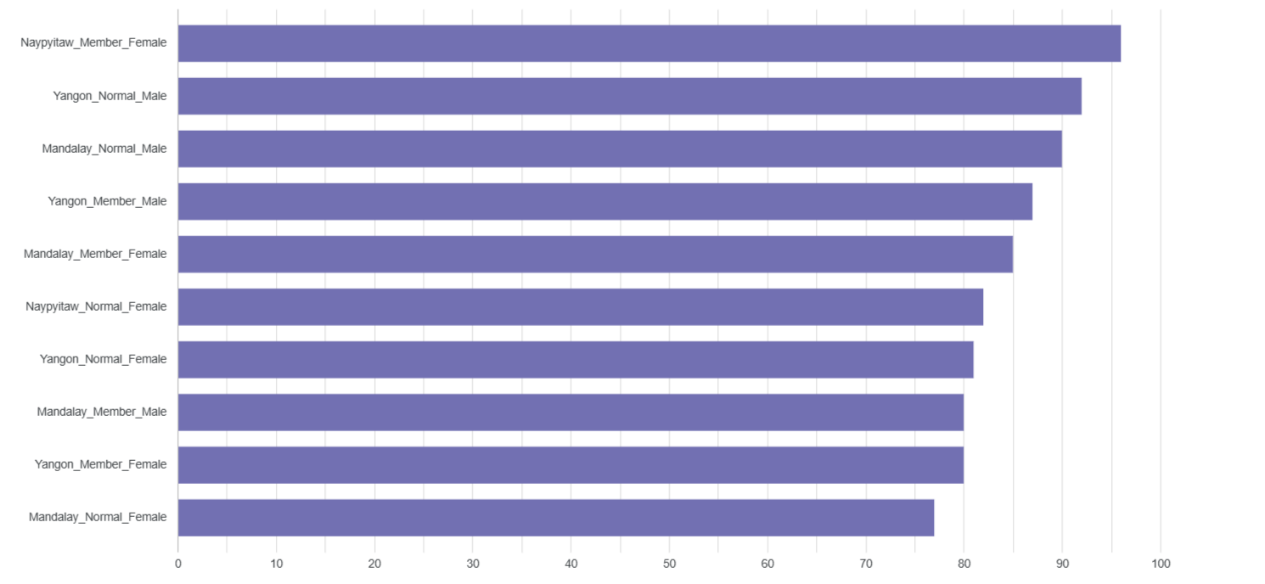
Frequency Analysis
Notes:
Average transactions: 77-92
Top 20% customers: 90+ transactions
Frequency correlates with loyalty
Key metric for retention strategies
Hans

Slide 11
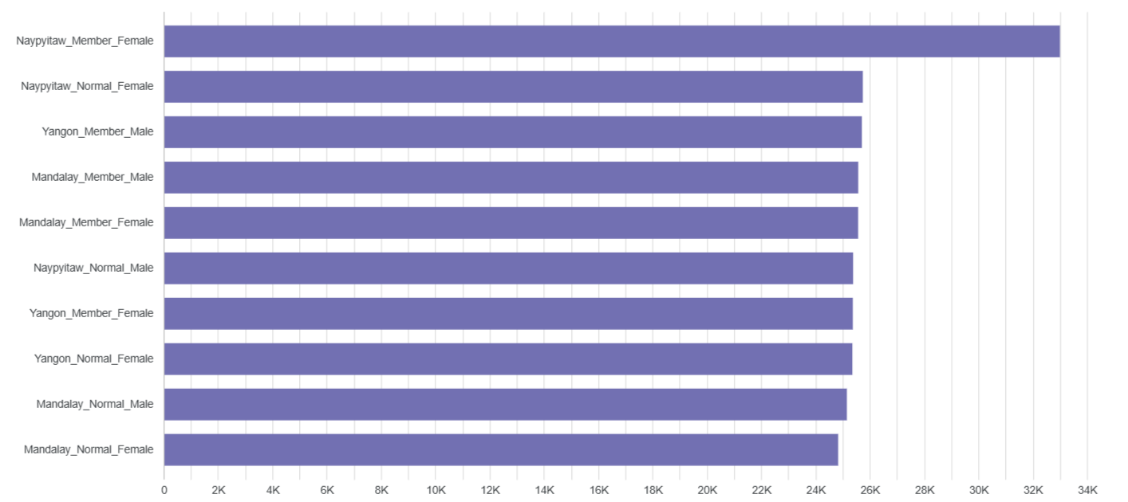
Monetary Analysis
Notes:
Spending range: $24.7k-$25.7k
Top 10% spenders: $25.5k+
Direct revenue impact
Identified high-value customer segments
Hans

Slide 12
Segmentation Approaches
Total Score:
Combined RFM score
Simple prioritization
Individual Scores:
Detailed labels
Targeted marketing
Notes:
Ridho

Slide 13
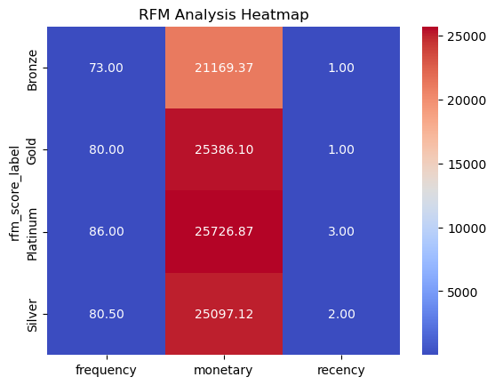
Total Score Approach
Notes:
Ridho

Slide 14
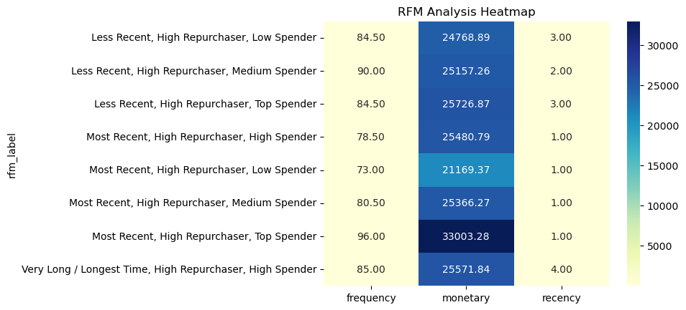
Individual Scores Approach
Notes:
Ridho

Slide 15
Strategic Recommendations
Platinum Tier: Exclusive rewards
Gold Tier: Upsell opportunities
Silver Tier: Retention focus
Bronze Tier: Re-engagement
Notes:
Ridho

Slide 16
Thank You!
Questions?
Notes:
Ridho

